Slide 1
1200 Ransom Street
Suite 102
Muskegon, MI 49442
231.766.7129
Program Coordinator: Suzanne Tanis
Email: stanis@volunteerdental.org
Facebook: Volunteer For Dental
www.volunteerdental.org

Slide 2
How Program Started
Replicated successful program in Battle Creek, MI
Small group of healthcare professionals:
Dr. Connie Verhagen (Pedodontist), Jackie Balcom Lindrup, RDH and Cheryl Schneider, BSN
Pilot study ran from 2011 – 2014
Access Health clients participated
Part-time Program Coordinator hired in January 2014 to open the program to the public

Slide 3
What We Offer
For the Whole the Community…
Basic dental care in exchange for volunteer service for those who qualify.
Dental Hub/Information Center: referrals to find a dentist and help getting answers to dental related questions.
Oral health education by a registered dental hygienist at our bi-weekly class.
Community outreach events and free oral health screenings in partnership with the Muskegon County Oral Health Coalition.
www.volunteerdental.org

Slide 4
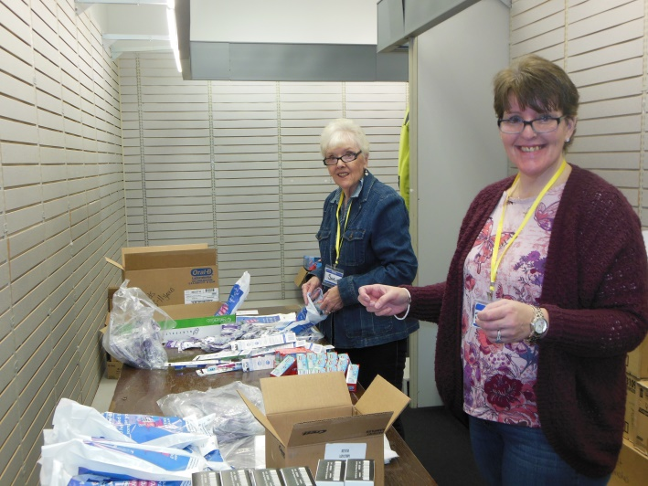
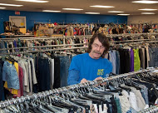
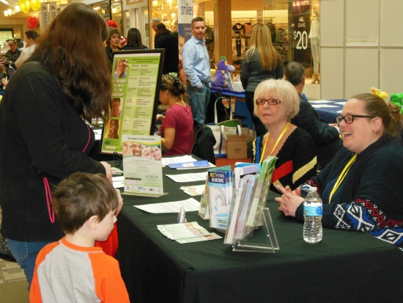
Program Participants
Qualifications:
Muskegon or Oceana County Residents
250% of Poverty or Less
Uninsured or under-insured
Low Income Adults, Seniors and Disabled Residents
Michigan has Healthy Kids Dental in every county as of 2016
Medicaid recipients referred to FQHC’s and Public Health Clinics
www.volunteerdental.org

Slide 5
What Makes the Program Work
Dental Services are provided by local private dentists
who do all the work for free in their office during the work week.
Services Offered:
X-rays
Exams
Fillings
Extractions
Prophylaxis
Periodontal Treatment
Endo
Limited flippers, partials
and dentures
How Participants Get Started:
Attend Dental Health Class
Complete volunteer hours
First appointment will be scheduled

Slide 6
Thank you to all of our participating dentists!
Jessica Bodenberg
Mark Burye
Peter Blackburn
Curt Cardon
Mike Cerminaro
Brian Cilla
James Donley
Jeffrey Dzingle
Karl Evanoff
Michael Fischer
Grant Gillish
Todd Hunt
Randy Kovicak
Monica Lakatos
John Leitner
Michelle Matheson
John Mullally
Patrick Mullally
Heather Phares
Timothy Reilly
Eric Sesselmann
Jessica Sneller
Robert Terry
Our program is successful because of your generosity!

Slide 7
What We’ve Accomplished Together…
In the first 3 Years:
Over 1,000 people helped at our dental hub
Over 300 people received dental care
Over 400 people attended oral health class
Over 10,000 volunteer hours completed
Over $300,000 in donated dental services
For every $1 invested in our program the community sees a $3 return

Slide 8
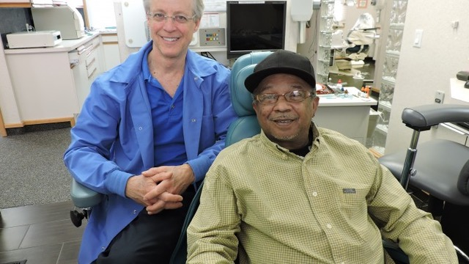
Funding For Volunteer For Dental
In Kind
Access Health donates an office, phones, computers, office machines and a classroom
Grants
Mercy Health Community Benefit Grant through the Health Project
Alcoa, Rite Aid, BCBS, Delta Dental, Greater Muskegon Service League, Women Who Care, Patterson Foundation,
Michigan Dental Association Foundation,
Muskegon District Dental Society
Individual Gifts

Slide 9
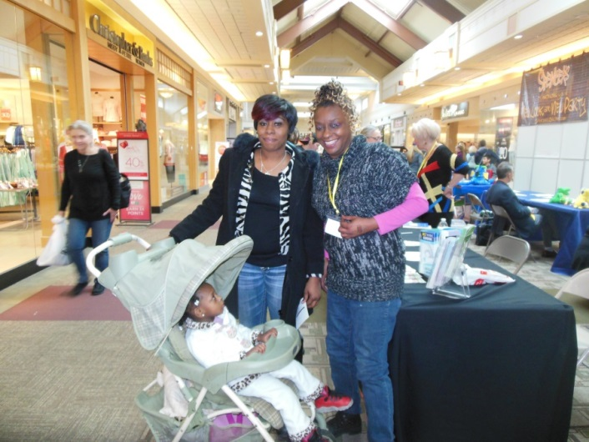
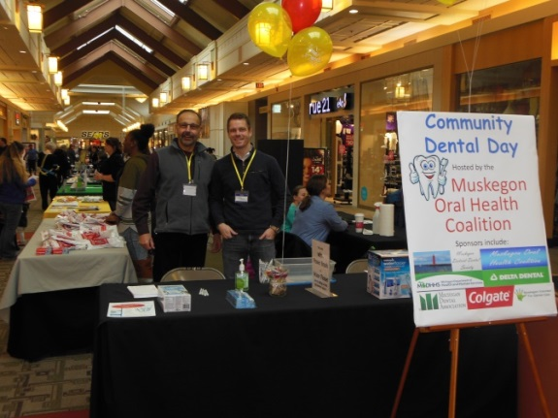
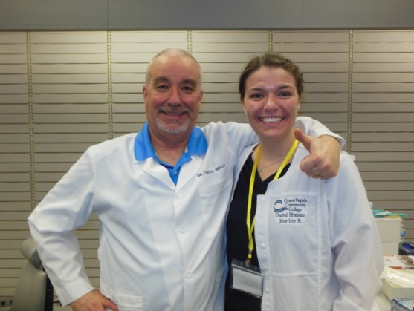
Michigan Department of Health and Human Services Health Innovations grant
Grant Period 10/2016-9/2017 VFD and MCOHC formally partnered
What we Received…
Part-time Community Outreach Coordinator
Multiple Community Education and Outreach Events
Oral Health Screening Events
MCOHC - new logo and oral health displays, banner, rack cards
VFD – new logo, pamphlet, website, bus ads, Facebook ads,
database and a program video

Slide 10
What We Accomplished
October 1, 2016 – September 30, 2017
23 Events (mall, schools, senior center, senior apartments, etc.)
Approximately 6,360 people reached
58 children and 31 adults screened
51 children and 18 adults received fluoride treatments
600+ children’s oral hygiene bags given
435+ adult oral hygiene bags given
9 Adult Crest Power Brushes given
85+ Kid’s Power Brushes given
3 Water Flossers given
Over $8700 in donated supplies and DDS time given
Over $3000 spent on supplies and giveaways
Most Important components:
Rethink Your Drink display
Oral Hygiene Instructions
Fluoride treatments
Toothbrush goodie bag giveaways

Slide 11
Imagine US
being the leader in caring
for the oral health needs
of our community
TOGETHER…
www.volunteerdental.org
Facebook: Volunteer For Dental
Program Coordinator: Suzanne Tanis
Email: stanis@volunteerdental.org

