Slide 1
Silver Diamine Fluoride

Slide 2
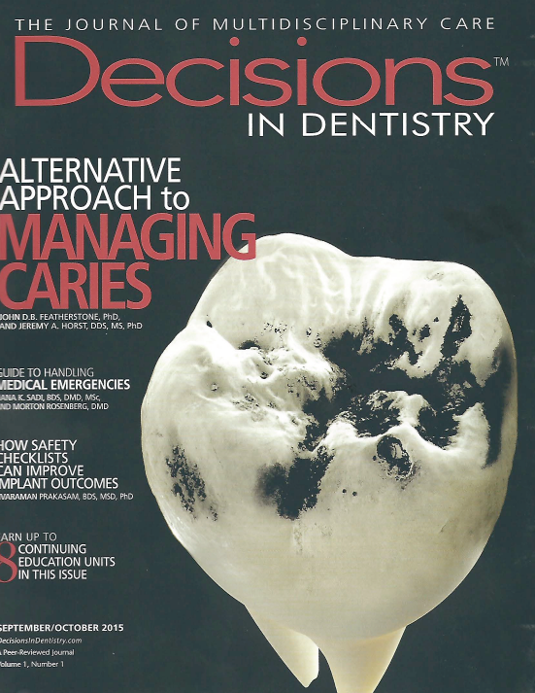

Slide 3
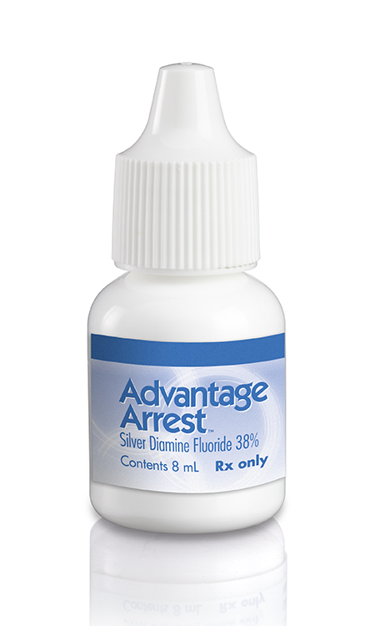
Advantage Arrest Silver Diamine Fluoride 38%

Slide 4
Advantage Arrest
FDA cleared as a dentinal hypersensitivity treatment (similar to fluoride varnishes)
For use in adults over the age of 21.
Increases Dentinal Hardness
Painless, Blocks dentinal tubules
50+ years of use in Japan, China, India, New Zealand, Australia and many others as Caries Arresting Agent
Quick, Affordable for Patients, and Cost Effective for the Clinic

Slide 5
How it works
Forms silver-protein conjugates in decayed surfaces
Increases resistance to acid dissolution and enzymatic digestion.¹¹
Hydroxyapatite and fluoroapatite form on the exposed organic matrix, along with the presence of silver chloride and metallic silver.⁵
Increases in mineral density and hardness while the lesion depth decreases.⁵
Inhibits the proteins that break down the exposed dentin organic matrix: matrix metalloproteinases;¹¹ cathepsins;¹² and bacterial collagenases.⁵
Silver ions act directly against bacteria in lesions by breaking membranes, denaturing proteins, and inhibiting DNA replication.^{13,14}
Ionic silver deactivates nearly any macromolecule.
Silver diamine fluoride outperforms other anti-caries medicaments in killing cariogenic bacteria in dentinal tubules.¹⁵
Silver and fluoride ions penetrate ~25 microns into enamel,¹⁶ and 50-200 microns into dentin.¹⁷ Fluoride promotes remineralization, and silver is available for antimicrobial action upon release by re-acidification.¹⁸

Slide 6
Toxicity?
One drop is approximately 25 μL and should be sufficient to treat 1-5 teeth and contains about 11.88 mg of SDF. LD of oral administration is approximately 520 mg/kg body weight; while LD subcutaneous administration is 380 mg/kg body weight. A child of 10 kg would receive 1.185 mg/kg.
If we use the 380mg/kg number being overly cautious, that is a 400 fold safety margin. The EPA has also set short term silver exposure levels in drinking water at 1.142 mg per L for 1-10 days.
Applications greater than one week apart fall in line with these recommendations. The EPA long term exposure limits have been set at 1 gram to safely avoid argyria.
According to Vasquez et. al. in the study below, the highest applied dose of 2.37 mg would enable 400+ applications over a lifetime. http://www.biomedcentral.com/content/pdf/1472-6831-12-60.pdf

Slide 7
Application

Slide 8
Advantage Arrest
Does not stain sound enamel or dentin
Does not stain when preventing sensitivity
Does discolor when applied on demineralization
The color changes are like naturally arrested caries or darker. It is a signal to both clinician and patient that something is happening.
Discolors soft tissue, and any other objects it touches (a few hours to appear, soft tissue fades in a few days)

Slide 9
Advantage Arrest
If stain is an issue, can be covered with Glass Ionomer.
Potassium Iodide has also been used to reduce the staining
Research is inconclusive about KI reducing stain, or reducing efficacy
Does not need light cured, air dries, excess can be rinsed away after application
Can be reapplied at intervals of > one week; one application is normally sufficient
Clear liquid, Light Sensitive
10 ml bottle filled to 8 ml
3 year shelf life

Slide 10
SDF Q&A
Does the application technique differ between the label indication of relief of dentinal hypersensitivity and the off label indication of caries control?
No
Is there a recommended frequency of application of silver diamine fluoride for caries control?
6 months to one year
Does the application of silver diamine fluoride to a lesion cause discoloration?
Yes
Can Advantage Arrest be used on a prepared tooth just prior to restoration cementation?
Yes
Are there any contraindications for the use of silver diamine fluoride for the control of caries?
Silver diamine fluoride should not be placed on exposed pulps. Other topical fluorides (e.g. fluoride varnish) should not be used in the same appointment. Studies have shown that 38% silver diamine fluoride conveys more effective protection against decay in other teeth than fluoride varnish with reduced overall fluoride exposure.
Is there evidence of caries prevention benefit to non-application sites following Advantage Arrest use for a patient?
Treating carious areas with silver diamine fluoride 38% acts as a whole mouth fluoride treatment. It can also be used in place of sealants in grooves. A protective effect has been shown to non-treated teeth and surfaces. These findings come from high quality randomized clinical trials.

Slide 11
SDF Q&A
Are there any post appointment instructions for the patient or the caregivers/guardians?
There are no postoperative limitations. Patients may eat or drink immediately. Patients may brush their teeth with fluoridated toothpaste on their regular schedule.
Does silver diamine fluoride stain skin, countertops, instruments etc.
Yes
A contraindication in the Advantage Arrest Package Insert states that patients with more than six affected sites are recommended for exclusion. What are the safety implications for application of Advantage Arrest for a patient that has more than six sites to be treated?
The Margin of Safety for the volume of product needed to treat six sites is within 130 times the NOAEL (no-observed-adverse-effect- level). Treating more sites in one visit will likely have little practical impact on patient safety; like protocols for fluoride varnish application, the suspension for several days of fluoride supplements is advised.
How does an arrested lesion treated with Advantage Arrest look like on radiographs?
Arrested lesions look like a scar on radiographs. You will observe radio-opacity as the mineralization of the previously softened dentin increases. Ultimately the best test of arrest is still the color change and tactile hardness of the dentin surface. It is advised that you educate your referring dentist about your use of Advantage Arrest since the appearance of a treated lesion might be new and confusing for many practitioners.
How can Advantage Arrest be coded using CDT?
D1208 - Topical application of fluoride
D 9910 - Application of a desensitizing medicament, per visit
D1999 - Unspecified preventive procedure by report
In 2016 there will be a new CDT code specifically for the use of caries arresting medicaments; the off-label use of Advantage Arrest.
Code D1354 - Interim caries arresting medicament application
Can Advantage Arrest be used as a cavity Liner?
Yes, Silver Diamine Fluoride (SDF) is cleared in the same FDA category as cavity liners. Although there are no head to head clinical trials comparing SDF as a cavity liner, it has been used successfully in this way. Silver Diamine Fluoride will not discolor intact enamel or dentin. SDF can discolor demineralized tooth structure brown/black. Some of this discoloration may shadow a restoration and can create less than optimal esthetic restorations.

Slide 12
CDT Codes
D1208 – fluoride application
D9910 – Application of a desensitizing medicament
2016 Code
D1354 Interim application of caries arresting medicament
Check with your coding and insurance advisors for more information.

Slide 13
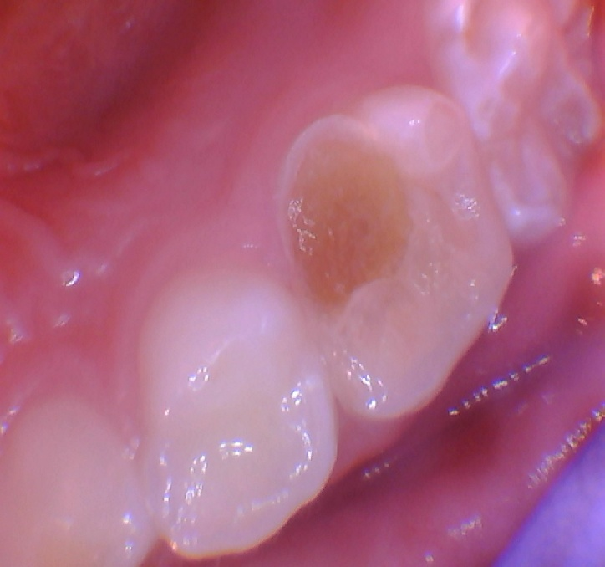
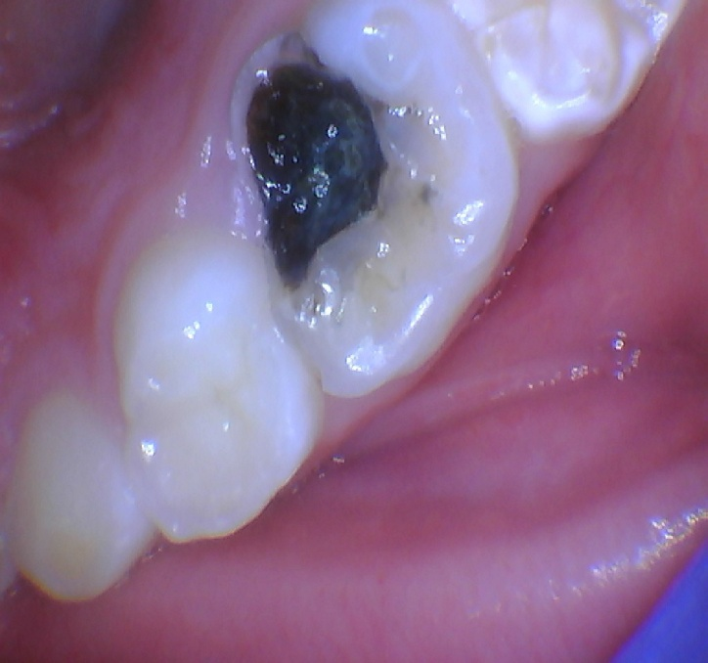
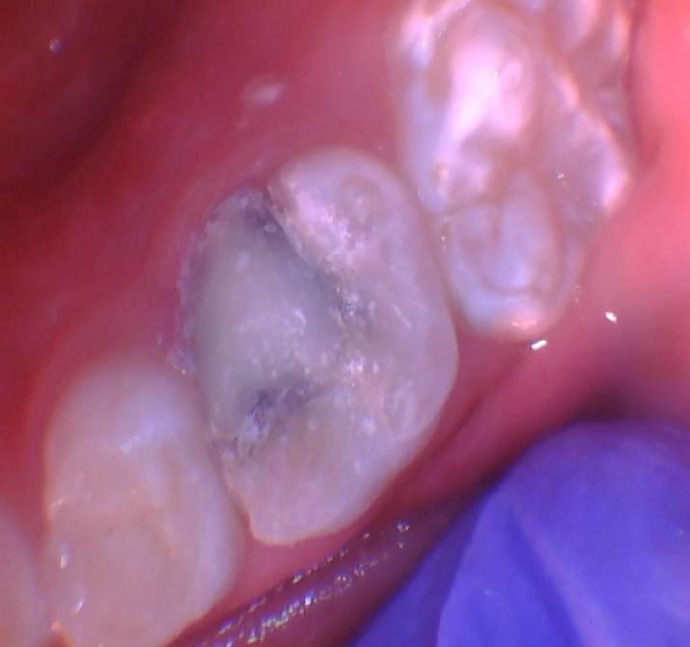
SDF + Activa
Dr. Josh Wren

Slide 14
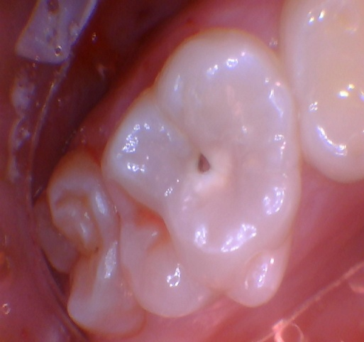
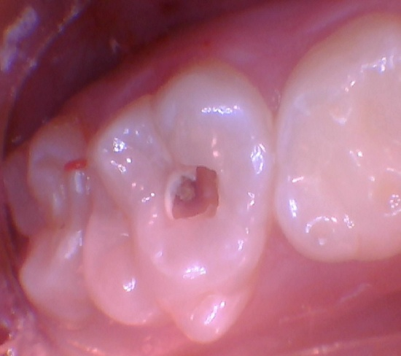
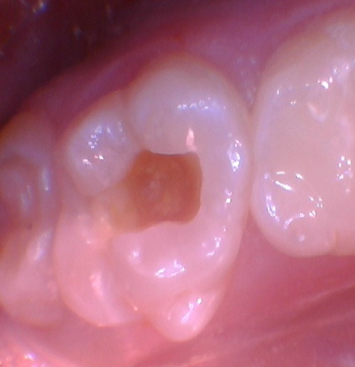
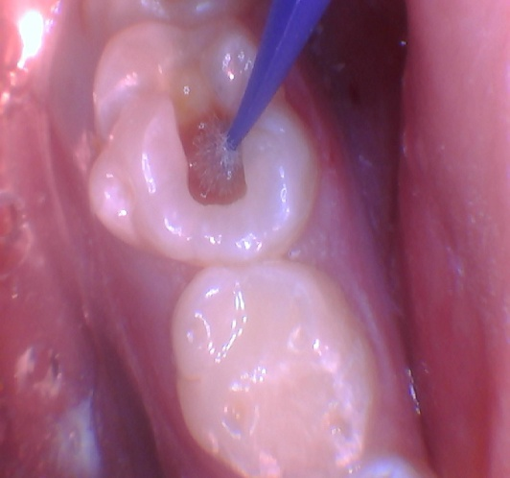
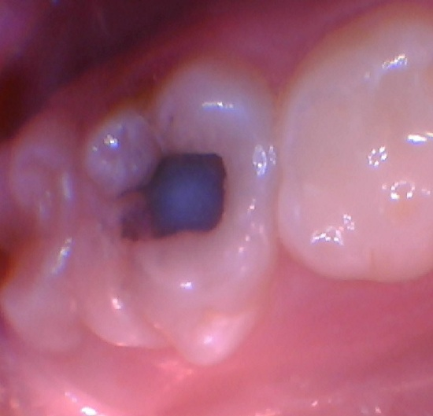
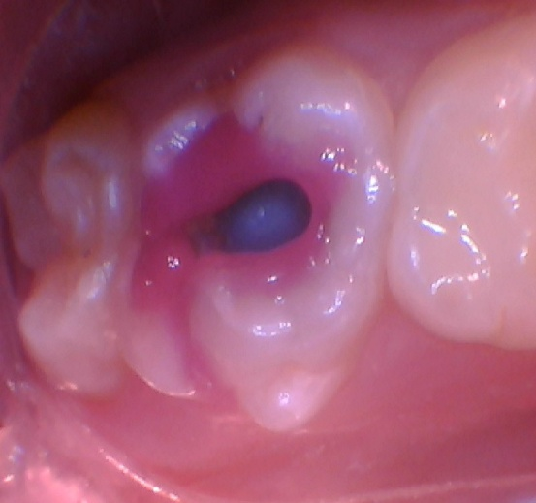
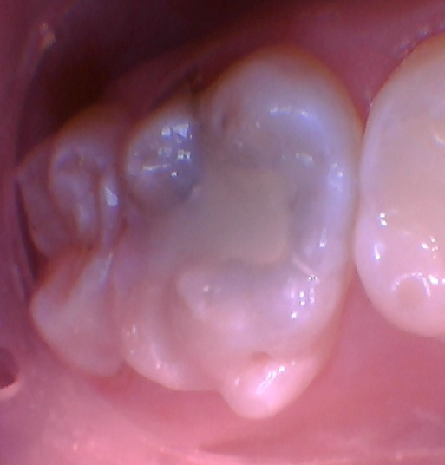
SDF + Activa
Dr. Josh Wren

Slide 15
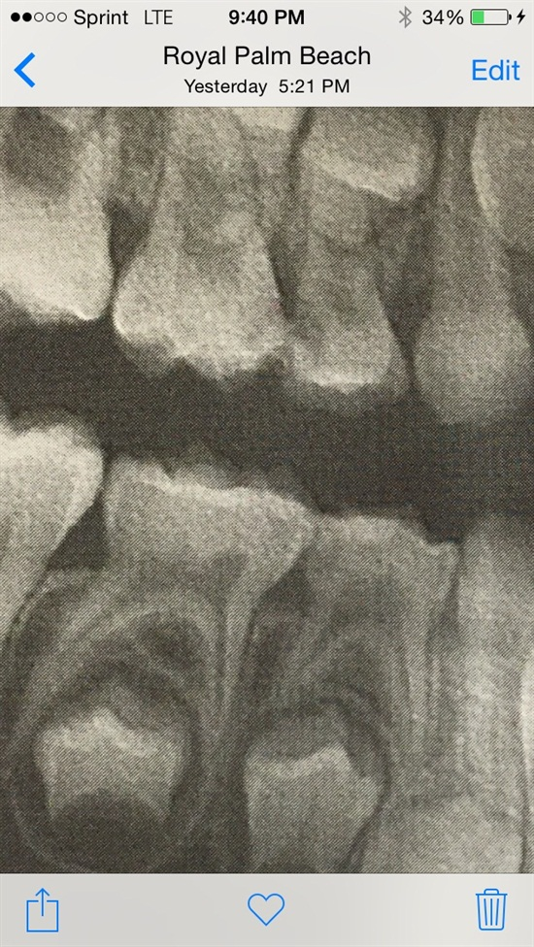
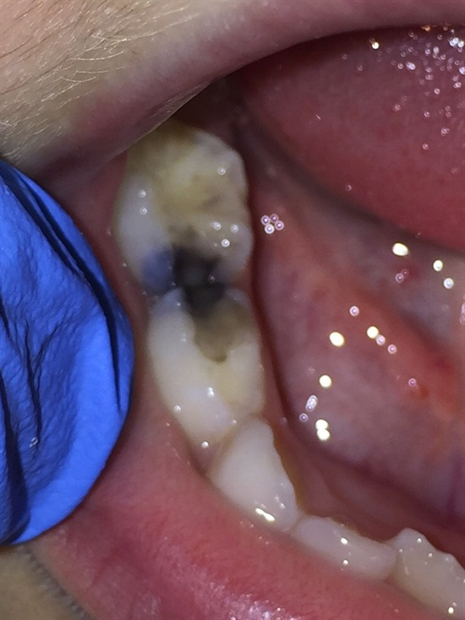
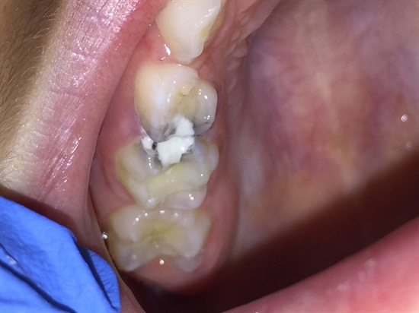
SDF + GI

Slide 16
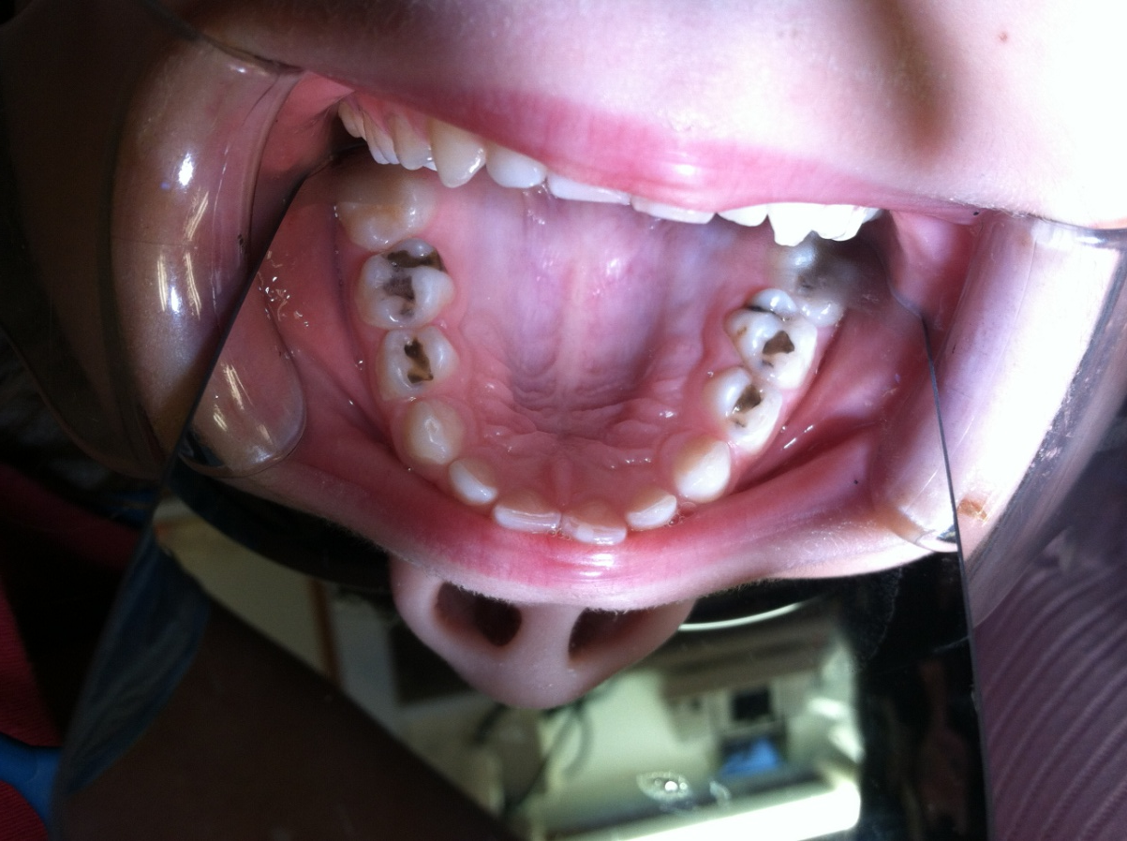
SDF
Dr. John Frachella

Slide 17
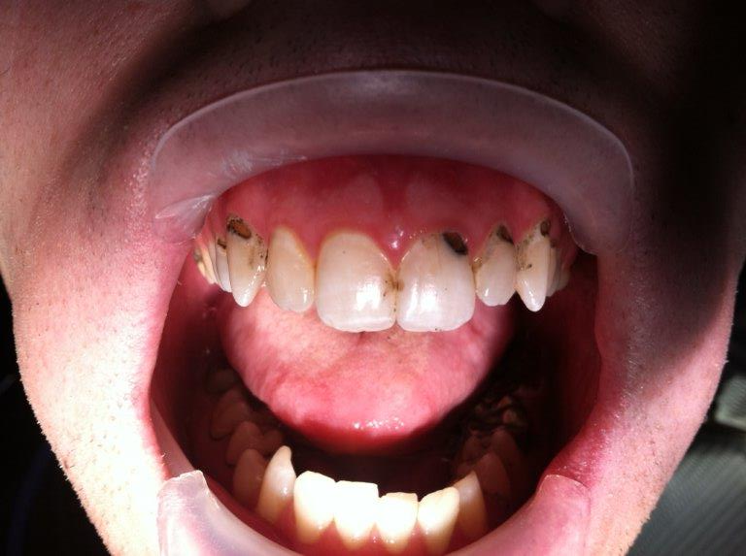
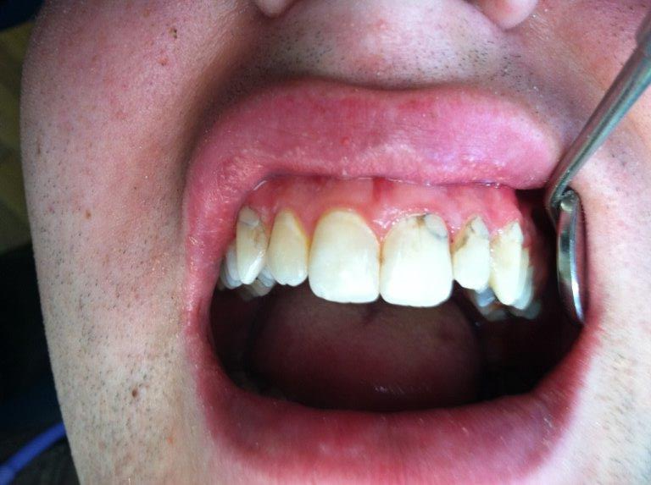
SDF
Post SDF Application
round bur w/o LA, acid etch, bond agent, light cured resin opaquer, light cured Majesty flowable
Dr. John Frachella

Slide 19
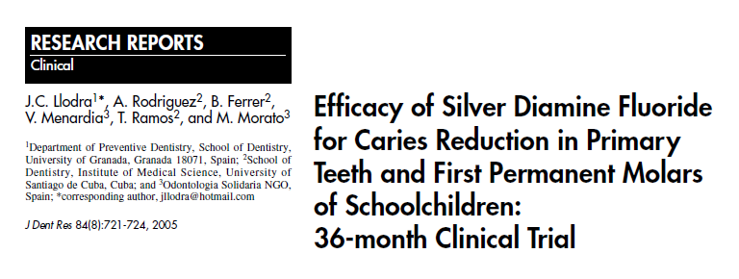

Slide 20
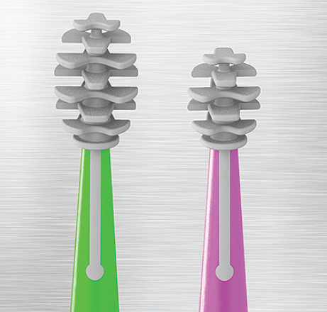
Applicators
Capillary action applicators
Two sizes – Regular (green) and small (pink)
Bend and hold shape

Slide 21
Advantage Arrest
Per application cost
$129 = 8 mL bottle = 250 drops = $0.50/Drop
$9.95 for 100 Applicators – $0.095 per app.
One drop application = $0.60 per application
Two drop application = $1.20 per application
Equal or less than Fluoride Varnish

