Slide 1
Dental Stem Cells:
Preparing for the future
Presented by
Lisa Darrow, RDH, BA, CDA

Slide 2
Agenda
Introduction
What are Stem cells?
What is Tooth Banking / Process
The Science behind Toothbanking
Dental Benefits (Practice/Patient)
Clinical Benefits/Applications
Affordability
Scientific Articles

Slide 3
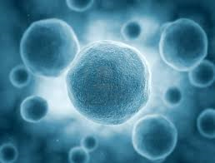
What are Stem Cells?
Adult stem cells are the body’s toolbox, called into action by normal wear and tear on the body, and when serious damage or disease attack.

Slide 4
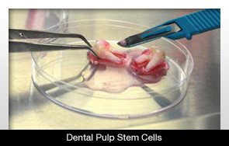
What are Dental Stem Cells?
Dental stem cells are located within the pulp of the tooth. They are known as DPSC’s (Dental Pulp Stem Cells) or MSC’s (Mesenchymal Stem Cells).

Slide 5
How do we store these dental stem cells?
        TOOTHBANKING

Slide 6
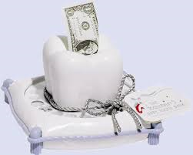
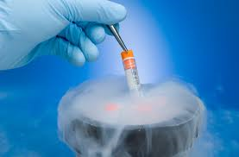
What is Tooth Banking?
  Not this type of Tooth Banking
  Tooth Banking is the cryopreservation of dental stem cells
  Similar to umbilical cord storage yet MUCH easier to access and MANY MORE uses
  Minimally invasive
  Located within the dental pulp are mesenchymal stem cells (Adult Stem Cells)

Slide 7
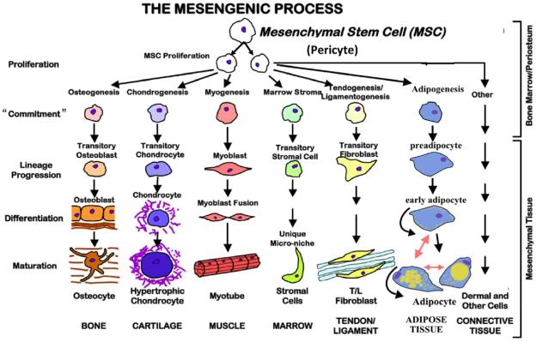
MSC Capabilities
While MSCs from various sources have shown the ability to differentiate into various tissues, research that we are spearheading, has shown that DPSCs may originate from the ectodermal embryonic lineage, which gives rise to the Nervous System.

Slide 8
Brief History/Science of Dental Stem Cells
2000 – Dental pulp stem cells discovered by a researcher at the National Institutes of Health
2003 – NIH announces viable stem cells are in dental pulp of teeth
2004 to present – Over 1,000 published studies identifying therapeutic potential of dental mesenchymal stem cells.
2008 – Surgeons from Spain announced the world’s first tissue-engineered whole organ transplant procedure, using a trachea made with the patient’s own adult mesenchymal stem cells
2009 – Scientists from Italy announced the first-ever human clinical application using patients’ own dental stem cells to repair mandibular bone defects.
2011 – A study showed that stem cells from teeth can create islet-like cells which produce insulin.
http://www.slideshare.net/RagaAhmed/dental-stem-cells-23369967

Slide 9
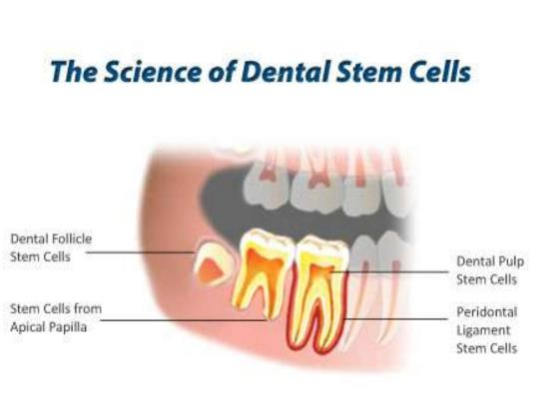
Dental Stem Cells are Mesenchymal stem cells, found in the dental pulp of all teeth.
Until recently, their ability to differentiate into various types of tissue has not been widely studied.
The Toothbank is changing this landscape both through driving the research to get these powerful cells to therapy, as well as by refining a proprietary technique to extract, and store this tissue for future use.

Slide 10
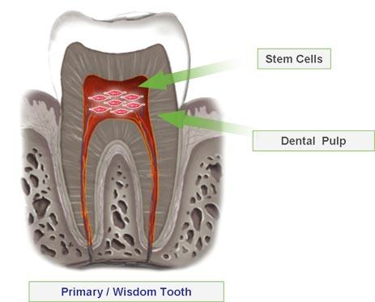
How are Dental Stem Cells Harvested?
Dental Stem Cells are harvested from the dental pulp tissue of deciduous exfoliated teeth, wisdom teeth primarily; however any healthy primary tooth will work as well.
Stem Cells within the pulp are a valuable source of highly regenerative stem cells.

Slide 11
What is considered Viable Stem Cells?
Integral supply of blood
Infection free – no deep caries or endo treated
Youth period since they are highly healthy plus the stem cells are highly reproducible.
Middle-aged persons’ permanent teeth can be feasible to retrieve stem cells from

Slide 12
Age for Harvesting
Under the age of 25 years is best
No age restriction currently - no charge to patient if no viable stem cells
The older dental stem cells the less reproducible

Slide 13
Deciduous Teeth
The perfect stem cell recovery tooth is incisor or canine at an initial stage of loosening, with the intact structure of the root being represented by more than one third

Slide 14
Harvest Zone
Deciduous canine to canine encapsulates the stem cells’ harvest zone (age 6 to 12)

Slide 15
Why not most Baby molars?
The pulp chambers of deciduous molars are likely to get destroyed by the growing permanent bicuspids as they get loose.
Normally, the remnant pulpal tissue may be insufficient in achieving a comprehensive stem cell recovery.

Slide 16
Wisdom Teeth
The entire or segmented sections of third molars entailing healthy pulp ought to be recovered during their extraction duration.
Growing third molars are characterized with increased pulpal tissue volumes compared to mature teeth with their roots entirely created.
Developing Wisdom Teeth (Enhanced Pulp chamber)

Slide 17
Wisdom Teeth
The most favorable recovery age for these teeth is within the developmental phase (roughly from 16 years to 20 years of age), since the stem cells are highly dynamic in root creation and holding up the structure of the root.
It is equally feasible to recover third molars made of healthy pulp at a later stage in life hence being perceived as a source for feasible stem cells.

Slide 18
Permanent teeth
A typical example of this argument is the bicuspids with the extraction need for orthodontic indications.
Some of the permanent teeth worth avoiding are: teeth having fresh infections, nonviable or endodontically-treated teeth, and teeth having stern periodontal infection and extreme mobility, teeth with calcified pulp or sclerosing chambers, as well as those with large restorations or deep caries.
Age is very vital. With age, the pulp-located stem cells tend to be less proliferative, hence the need to have stem cells recovered at the earliest and most convenient chance.

Slide 19
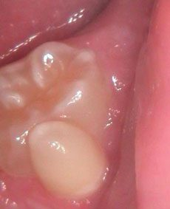
Mesodens or Supernumerary
Most of the time when such teeth are extracted, their whole root is still intact, in addition to having healthy pulp and intact blood supply.

Slide 20
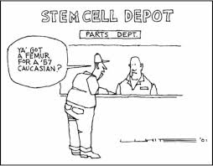

Slide 21
Process
Patient Consultation
Extraction of tooth/teeth and placement in Tooth Bank Kit
Ship Kit from Dental Office (via prepaid FedEx)
Lab Processing
Cryopreservation (Endless Benefits)

Slide 22

Patient Consultation
Soft introduction to Stem Cell Storage:
  “I want to let you know about a service that we offer all of our patients. It gives them the ability to store their stem cells for future medical needs.”
  “They have already used these type of stem cells, known as MSC’s, for a multitude of diseases, such as Parkinson’s, Alzheimer’s, and Diabetes.”
  “I don’t want you as my patient to come back to me and say, “why didn’t you tell me you offered this service, so I am letting you know today.””

Slide 23
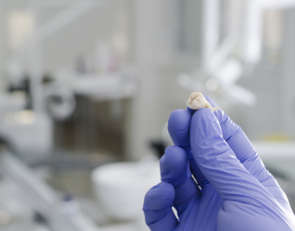
Extraction of Tooth/Teeth
Deciduous teeth and Wisdom Teeth are the best candidates (most likely to be exfoliated or extracted)
Tooth must have blood flow to have viable stem cells

Slide 24
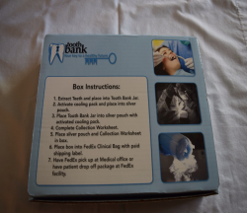

Delivery of Stem Cells
Tooth/Teeth placed in Toothbank Kit.
Prepaid shipping and packaging – FedEx called and package picked up from dental office.

Slide 25
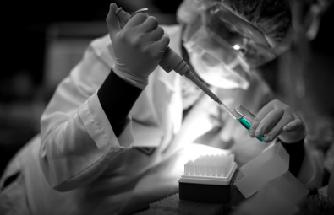
Lab Processing
Tooth/Teeth are received at Lab for dental stem cell harvesting, enrollment processing, viability, and stem cell count.
(If No stem cell are present, dentist receives a new Toothbank kit and patient is not billed by Toothbank).

Slide 26

Tooth Harvest and Washing
Extracted wisdom teeth prior to tissue removal
Each tooth undergoes disinfection through a series of washing steps, using Listerine type disinfectant followed by iodine solution.
Washing reduces or removes blood and other pathogenic particles that could lead to contamination of expansion culture.

Slide 27
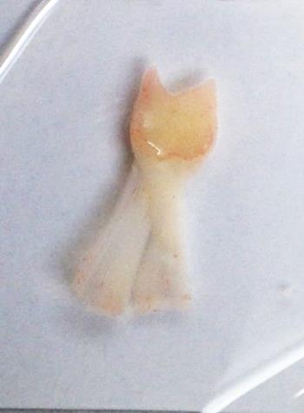
Tissue Extraction
Toothbank uses a precise technique to carefully crack open the tooth and remove the tissue.
Once the tissue is removed from the tooth, it is minced using scalpel blades, and digested using collagenase type solution to break down the tissue into single cell suspension.

Slide 28
Tissue Digestion and Culturing
Following tissue digestion into single cell suspension, the cells are plated.
ONLY the Mesenchymal Stem Cells stick to the plate. Other types of cells, blood cells, bone, cartilage, muscle, neuron, etc. remain in suspension and are washed off with the first media change.

Slide 29
Isolation and Expansion
Cells are cultured in Mesenchymal Stem Cell Maintenance media, allowed to proliferate and passaged once confluent. Once a culture is established, the cell double approximately every 2 days. This allows the ability to expand the cell number in order to achieve an appropriate number of cells to be therapeutically relevant.
1 day post culture 5 days post culture 7 days post culture

Slide 30
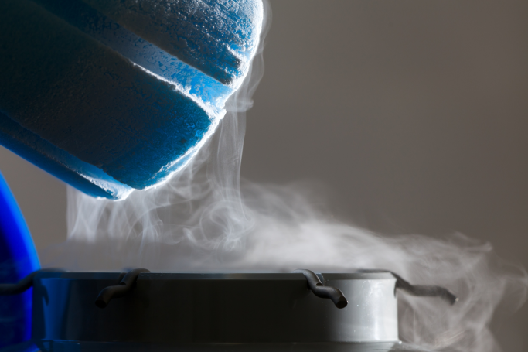
Cryopreservation

Slide 31
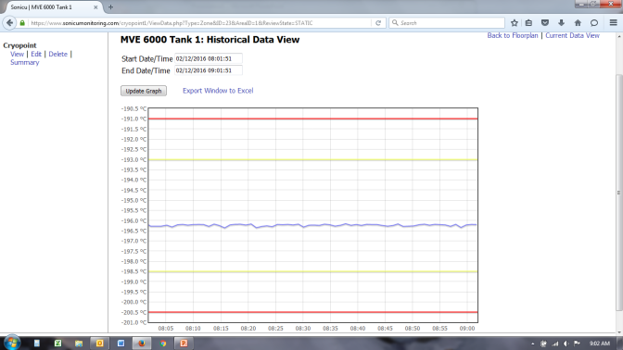
Temperature Monitoring
DPSC tissue is stored at LN2 temperatures (<-150C)
Toothbank uses a real time temperature monitoring system to monitor the temperature inside liquid nitrogen storage tanks.

Slide 32
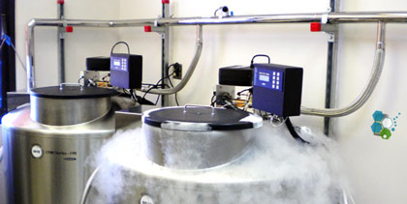
Dental Stem Cell Storage
Stem Cells are preserved through cryopreservation and can be stored indefinitely.
Secure. Stem cells are stored in two locations: Utah and Indiana for ultimate security.

