Slide 1
Oral Health America’s Wisdom Tooth Project
educate | connect | advocate
for the oral health of older adults

Slide 2
OHA Mission and Priorities
Oral Health America changes lives by connecting communities with resources to drive access to care, increase health literacy and advocate for policies that improve overall health through better oral health for all Americans, especially those most vulnerable.
OHA employs strategic partnerships and communications that emphasize the connection between oral and overall health

Slide 3
About OHA
National nonprofit organization based in Chicago, celebrating 61 years of focusing on the nation’s oral health.
We are a voice for vulnerable populations.
We focus on children, older adults, & health equity through our programs.
www.oralhealthamerica.org

Slide 4
What is
the Wisdom Tooth Project?
EDUCATE older adults and their care advisors
CONNECT communities with support and resources to access care
ADVOCATE for oral health of all older adults, especially those most vulnerable
A national program designed to:

Slide 5
Wisdom Tooth Project’s Strategies
TOOTHWISDOM.ORG
ADVOCACY
HEALTH EDUCATION & COMMUNICATIONS
PROFESSIONAL SYMPOSIA
DEMONSTRATION
PROJECTS
toothwisdom.org connects older adults/caregivers to information and local resources through a clickable map
Publishes A State of Decay, with state-by-state analysis of public health and service delivery rankings
Oral Health Educational Workshops for community-dwelling older adults & ongoing Communications Campaigns
Professional Symposia for multiple health and aging disciplines to discuss issues and design solutions
Demonstration Projects to discover promising practices and strategies for future development

Slide 6
Toothwisdom.org

Slide 7
“Health Professionals” section of Toothwisdom.org
Browse by profession or topic area
Resources grouped by type

Slide 8
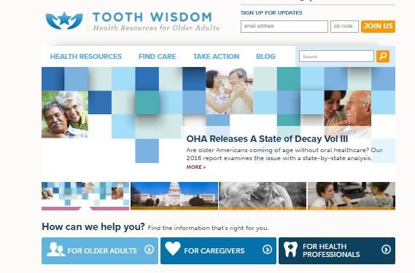
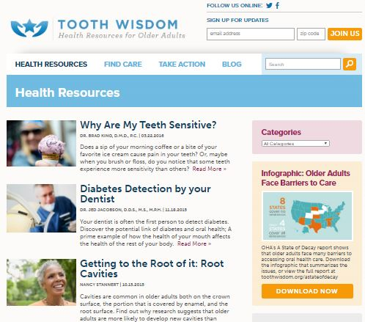
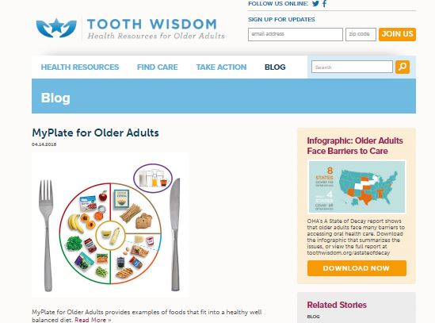
Health Resources & Blog

Slide 9
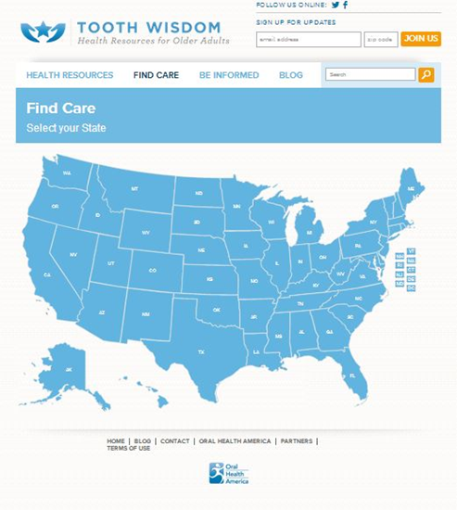
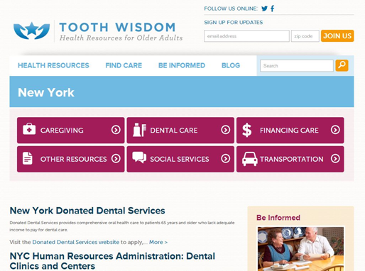
Find Care:
Clickable Map to State Pages

Slide 10
Toothwisdom.org to Date
Growth of toothwisdom.org web portal
More than 14,000 unique visitors a month accessing over 200 content-rich pages
More than 105,000 lifetime visits
On average, over 100 subscribers sign up for more information each month using the web site
Added new resources and capacity:
30 Blog posts
25 Professional resources
Soliciting new authors for original content

Slide 11
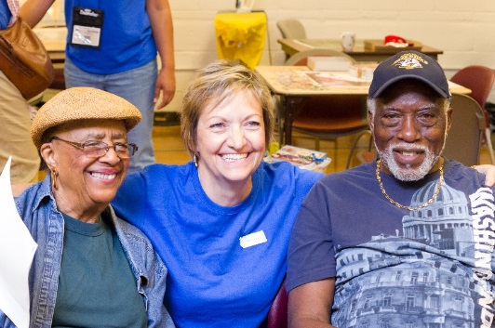
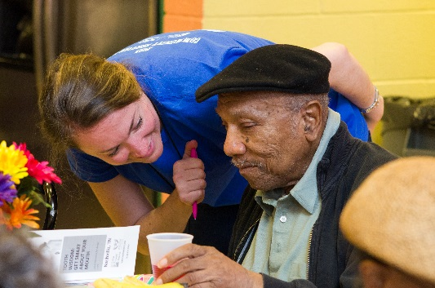
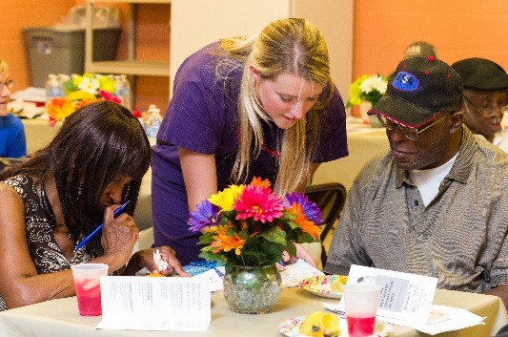
HEALTH EDUCATION & COMMUNICATIONS
Stakeholder newsletter, Wisdom Tooth Insider expanded to over 3,800 subscribers
OHA’s oral health curriculum for older adults, Tooth Wisdom: Get Smart About Your Mouth, for delivery in community settings across the country

Slide 12
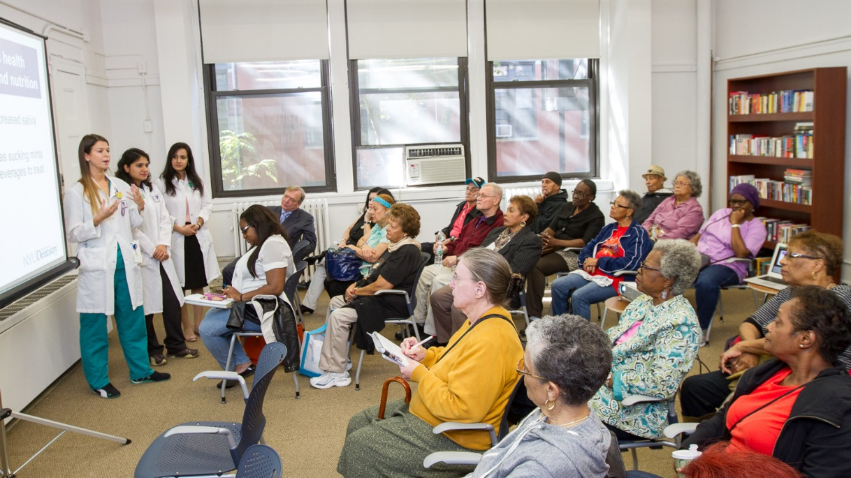
TOOTH WISDOM:
GET SMART ABOUT YOUR MOUTH
12

Slide 13
Tooth Wisdom:
Get Smart About Your Mouth
Tooth Wisdom: Get Smart About Your Mouth is a brand new, first-of-its-kind, oral health education workshop for community dwelling older adults
Workshop for older adults delivered in settings where they naturally congregate: senior centers, libraries, senior living communities, places of worship
Encourages older adult participants to recognize that prevention is critical at all ages
Demonstrates good oral hygiene practice
Participants take a pre/post assessment
Receive oral hygiene products and list of resources within their community & tip sheets

Slide 14
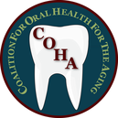
Community Partners
ADHA State Chapter
Recruit Hygienists to be trained, schedule and host day of training
Aging Organization
Schedule workshops in community senior centers
State’s Oral Health Coalition
Promote/advertise the project and provide any needed support
Funded by:

Slide 15
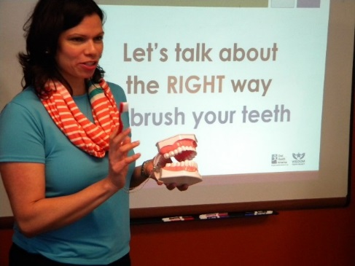
TOOTH WISDOM:
GET SMART ABOUT YOUR MOUTH
2015 Results
Approximately 1000 older adults,
Across 62 workshops,
Trained 145 hygienists in 5 markets: MI, IL, TN, OR, and MN
When asked if the workshops helped participants feel more confident to manage their oral health.
Chart reflects data from workshop participants that responded to the survey during 2014 and 2015 (n=841)

Slide 16
Michigan 2015 Pilot Demographics
Close to 500 older adults were reached
444 completed demographic info

Slide 17
Michigan 2015 Demographics (cont.)
45% had only Medicare
50% visited a dentist in the last 6 months
49% visited the dentist for a regular check-up
Looking forward to
expanding in 2016!

Slide 18
Future Directions of TW:GSAYM
Revise curriculum based on pilot results/feedback
Use pilot results to attract research entity for more comprehensive trial
Roll out in additional cities of the current pilot states
Obtain funding for national dissemination
Explore an online training module

Slide 19
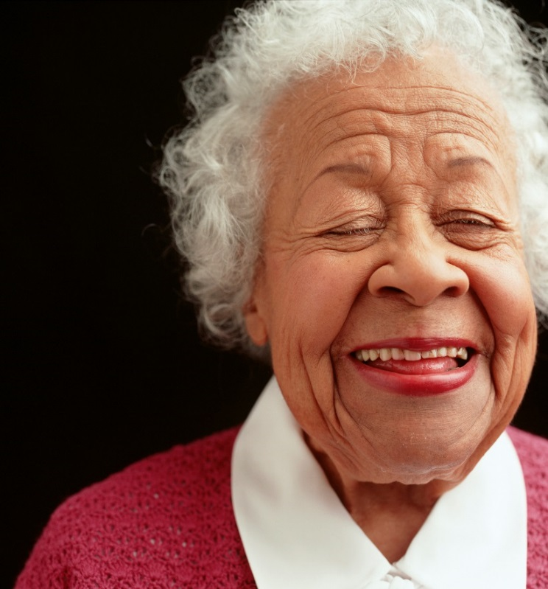
THANK YOU
Tina Montgomery
Program Director
tina.montgomery@oralhealthamerica.org
Andie Kyros
Program Coordinator, Older Adults
andie.kyros@oralhealthamerica.org

